Slide 1
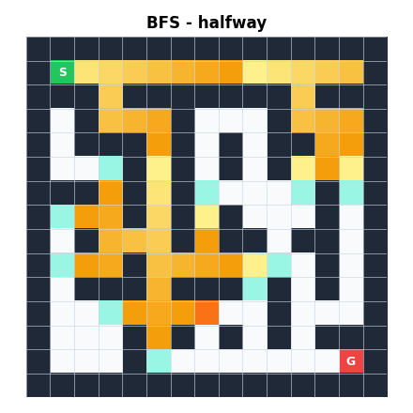
Maze Solver Game
Comparing BFS, DFS and Backtracking
“An interactive maze game that visualizes and compares BFS, DFS and Backtracking.”
Team: N . Vinesh Goud (25MVCSMR0064)
I . Pranav Reddy (25MVCSMR0040)
K .Poorna Chary (25MVCSMR0041)
Shaik Faraaz (25MVCSMR0079)
College: Malla Reddy Technical Campus
Domain: Design
BFS exploring a maze, drawn by our app
Notes:
Hello judges, we are [team]. Every computer science student learns BFS, DFS and Backtracking, but most only see the final answer on paper. We built the Maze Solver Game so you can watch the algorithms think.

Slide 2



The Challenge
Real-world context
Why it matters
Key challenges
Route finding powers maps, games, robots and networks
Students memorize “BFS = queue” but cannot picture it
Show HOW, not just the answer
Compare fairly
Keep it simple
Notes:
Route finding is everywhere. The problem is that students memorize the rule but cannot picture the search. Our challenge: show HOW the answer is found, compare fairly, and keep it simple.

Slide 3
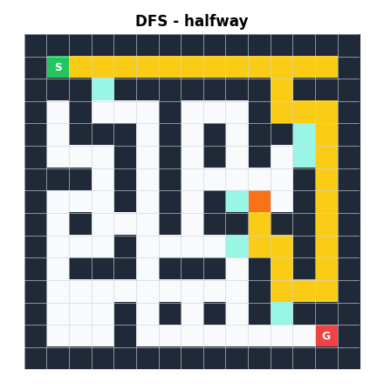
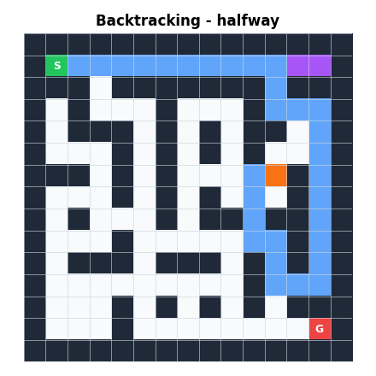
Our Innovation
The user can see HOW the algorithm finds the solution, not just the final path.
BFS: spreads in rings
DFS: dives deep first
Backtracking: undoes dead ends
Plain-English message at every step · Same maze for all three algorithms
Notes:
Instead of just showing the final path, the app replays every decision: which cell is explored, where it hit a dead end, and which choices were undone. All three algorithms run on exactly the same maze.

Slide 4








How It Works
Input
Maze
Algorithm
Search
Path
Metrics
Comparison
Size, level, algorithm
2D grid of S . # G
BFS, DFS, Backtracking
Every decision recorded
Start to Goal
Length, cells, time, undos
Table and charts
Every decision is recorded as an event, then replayed step by step
Notes:
You choose size, difficulty and algorithm. The app builds the maze, the algorithm searches and records events, then we get the path, the metrics and a comparison on the same maze.

Slide 5



Technology & Algorithms
Technology
Algorithms
Python
Algorithm | Why chosen | Structure | Time
BFS | Shortest-path guarantee | Queue | O(R×C)
DFS | Deep exploration | Stack | O(R×C)
Backtracking | Choose, explore, undo | Recursion | O(R×C)
Readable, great for algorithms
Streamlit
Web UI in pure Python
Matplotlib
Maze drawing and charts
R×C = rows × columns. Backtracking marks tried cells, so its time stays linear.
Notes:
BFS: queue, shortest path in an unweighted maze. DFS: stack, goes deep first, finds a path but not always the shortest. Backtracking: recursion that follows choose, explore, dead end, undo, try another, and we count every undo.

Slide 6
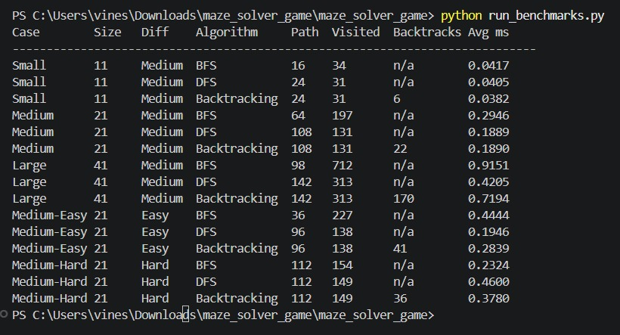
Demo & Impact
Algorithm | Path | Visited | Undos | Time
BFS | 64 |  | n/a | [INSERT]
DFS | 108 | 131 | n/a | [INSERT]
Backtracking | 108 | 131 | 22 | [INSERT]
Practical benefits
Easier learning of algorithms
Instant side-by-side comparison
Ready for classroom use
Notes:
Compare All runs the three algorithms on exactly the same maze, same start and goal. On this maze BFS found a 64-step path, while DFS and Backtracking found 108 steps but visited fewer cells. This is one maze only; other mazes can differ. Show your live demo and screenshots here.

Slide 7



Future Vision
Achieved
Next
Scalability
3 algorithms
Live step-by-step replay
Fair comparison
9 automated tests
A* and Dijkstra
Weighted mazes
Click-to-draw editor
Quiz mode
Explicit-stack backtracking
Benchmark many mazes
Thank You
Notes:
We built three algorithms, a live replay and a fair comparison, tested with nine automated tests. Next: A* and Dijkstra, weighted mazes, a click-to-draw editor and a quiz mode. Our motto: Dont just learn how algorithms work, watch them work. Thank you!

